Slide 1
So you want to Cad a part?

Slide 2
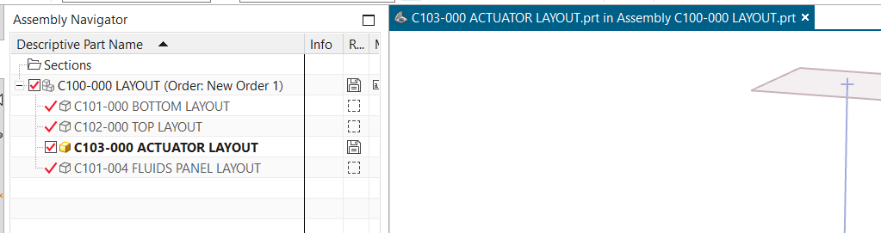
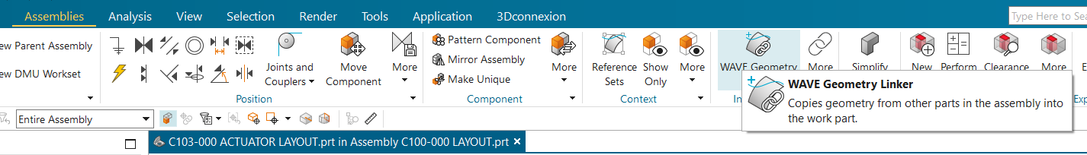
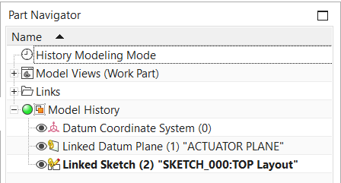
Bringing geometry into your layout
Each major assy has “-000” Layout as the main file where you “do” the cad
To bring in reference geometry:
Double click on layout file to enter in context
Under Assemblies, open “Wave Geometry linker”
Select the things you want, bodies, planes, sketches etc
Objects show up in your assembly as “linked”
You can bring parts from all other layouts adjacent assemblies, not just the top one!

Slide 3
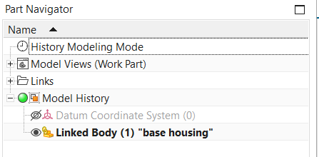
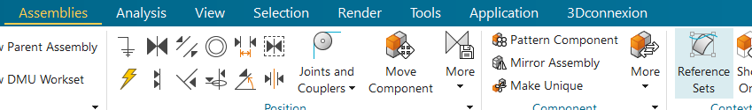
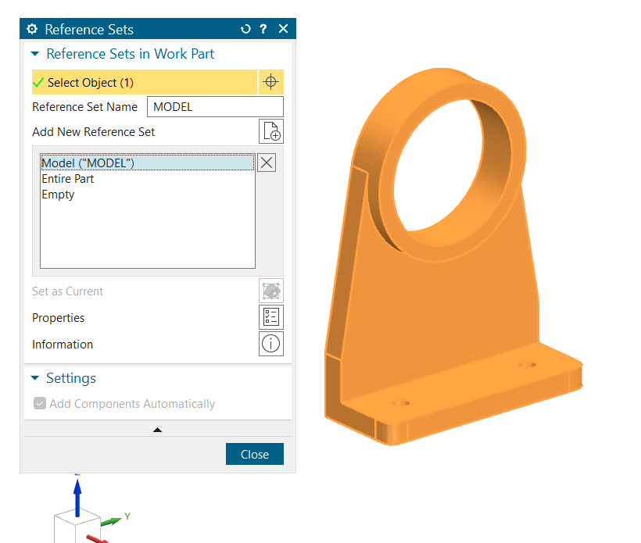
Making Your Part File
So you cadded all the parts in the layout file as bodies, cool!
Make an empty part file Following “C-10X-00Y PART NAME”, where X matches the layout and Y is a new number.
Put empty part file in the layout using “add component
Using wave link, bring in just the body you want
Hide the datum coordinates, and add the body to the reference set
And that’s it!
Your layout at the end should contain all parts in the assembly AND any subassemblies

Slide 4
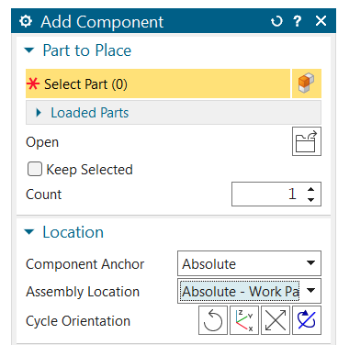
Assemblies (-50X)
Assemblies live in parallel to the layout system
Assemblies NEVER use constraints
They break all the time
MOVE by constraint is what you want
Only add parts using absolute coordinates, and they’ll automatically be in the right place in space
Using assembly patterns is OK and highly recommended!
Adding cots parts is annoying, we’ll figure out what we want to do
Maybe have a COTS KIT to contain the mess to one thing

Slide 5
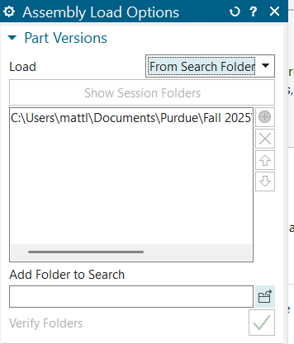
Nx can't find the part I want to load
A drawback of using github is it saves parts to the local path of the computer it was saved on, so you need to switch to using search folders
Search “Assembly load options” in top bar
Select from seach folders
Select top level folder of the repo
This is annoying but It'll take 2 seconds every time you open NX
For this reason, we will be saving all PNs to one big folder, annoying but it means you only have to add 1 folder every time

Slide 6
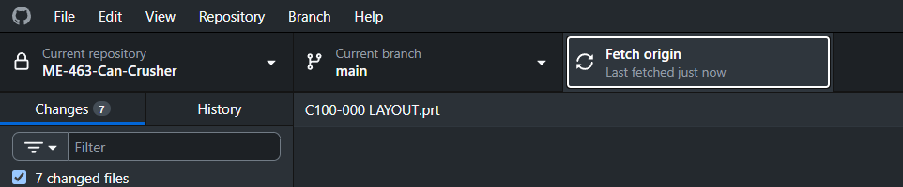
Saving and Pushing to github
This system lets us work on cad in parallel as long as we’re working in different layouts
If we save over each other, we will lose work!
What we can do to avoid this
Push / Pull as often as you can, it takes 2 seconds!!!!!!!
Message the team if you’re going to change the top level layout
Stay vocal about what cad you’re working in
Don’t save a layout if you think someone else is working on it
This wasn’t an issue previously bc we knew generally who was working on what, so I think we’ll be ok

Slide 7
PN TREE / FLOW
C100-000
LAYOUT
C101-000
SUB ASSY 1 LAYOUT
C102-000
SUB ASSY 2 LAYOUT
C10X-000
SUB ASSY X LAYOUT
C101-001
SUB 1PART 1
C101-00X
SUB 1PART X
C101-001
SUB 1PART 1
C101-00X
SUB 1PART X
C10X-00Y
PART Y
C101-501
SUB ASSY 1
ASSEMBLY FILE
C101-501
SUB ASSEMBLY
C100-501
TOP LEVEL ASSEMBLY

Slide 8
C100-000
LAYOUT
General Numbering
C101-000
SUB ASSY 1 LAYOUT
C102-000
SUB ASSY 2 LAYOUT
C10X-000
SUB ASSY X LAYOUT
C101-001
SUB 1PART 1
C101-00Y
SUB 1 PART Y
C102-001
SUB 2 PART 1
C102-00Y
SUB 2 PART Y
C10X-00Y
PART Y
C10X-501
SUB ASSY X
ASSEMBLY FILE
C101-501
SUB ASSY 1
ASSEMBLY FILE
C102-501
SUB ASSY 2
ASSEMBLY FILE
C100-501
TOP LEVEL ASSEMBLY FILE

Slide 9
So you want to use the drawing template?
Good thing it’s ezpz

Slide 10
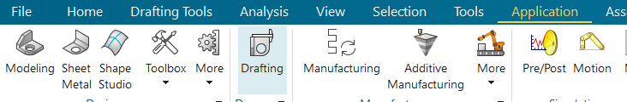
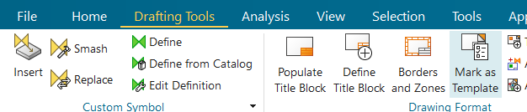
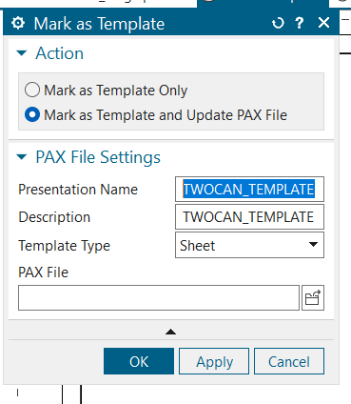
Load TEMPLATE
Load TEMPLATE.PRT and go to drafting application
Go to Drafting Tools and click mark as template
Mark Template and update PAX file, then save TEMPLATE.prt

Slide 11
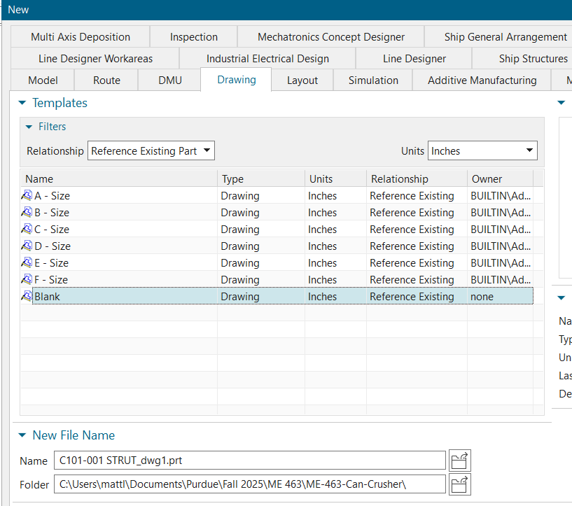
Make New Drawing
Load part you want to make a drawing of
Make new drawing file: file->new
Set type to drawing and sheet size to blank
Click OK to make new file

Slide 12
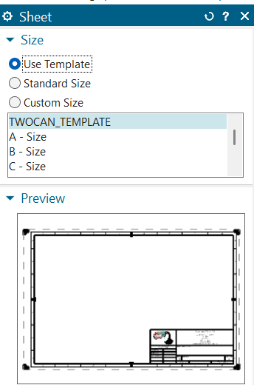
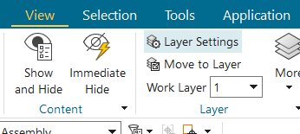
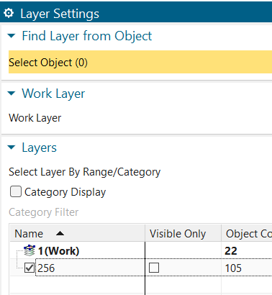
Set Up Drawing
You’ll be prompted to pick a sheet size
Use template->TWOCAN_TEMPLATE
The title block exists in layer 256, which is hidden
Go to view-> layer settings
Check box to activate layer 256

Slide 13
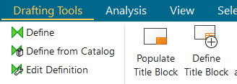
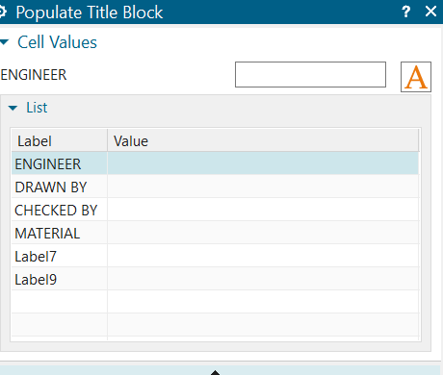
Fill out title block
Drafting Tools -> Populate title block
Fill out ENGINEER, DRAWN BY (you) and (MATERIAL
Use “M. LEWTON” or “B. LAMARCA” format for names

Slide 14
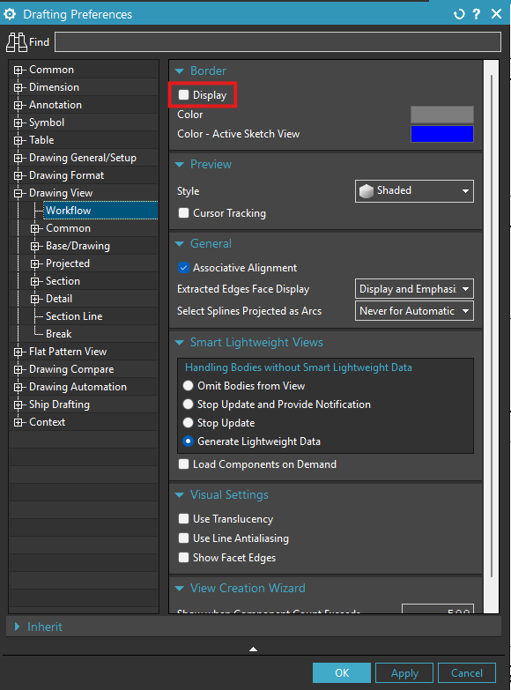
Hide border around views
File -> Preferences -> Drafting -> Drawing View -> Workflow -> Uncheck “Display”

